Slide 1
Treasury and Trade Solutions | Citi Commercial Cards
Citi® Commercial Cards – APOC/Alternate User Creation

Slide 2
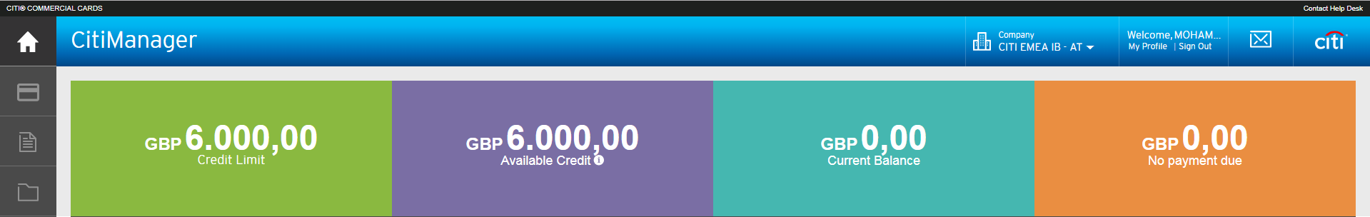
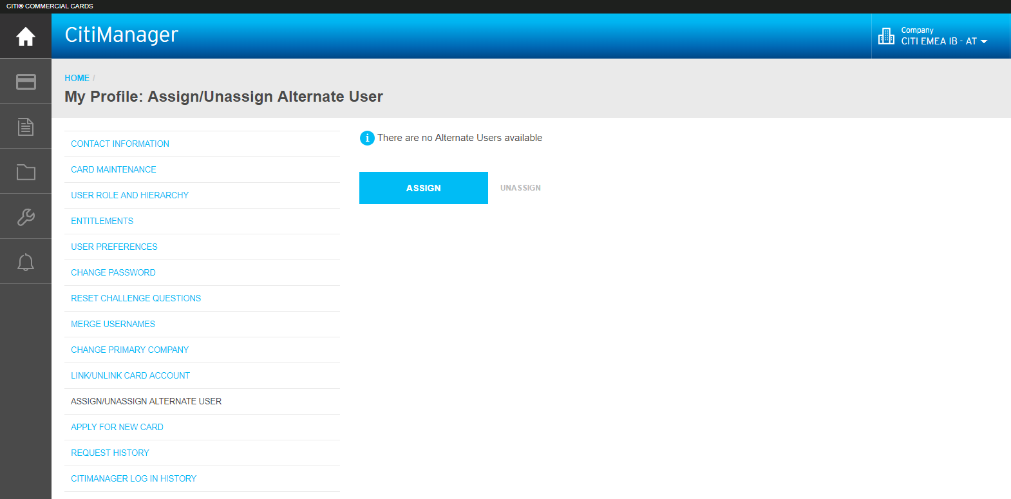
Process overview – Adding APOC or Alternate User
Alternate Point of Contact is functionality available for cardholders who need assistant for their everyday card management
Quick Steps
Login to CitiManager and click on ‘My Profile’
Select on ‘Assign/Un-assign Alternate User’
Click on ‘Assign’
1
3
2

Slide 3
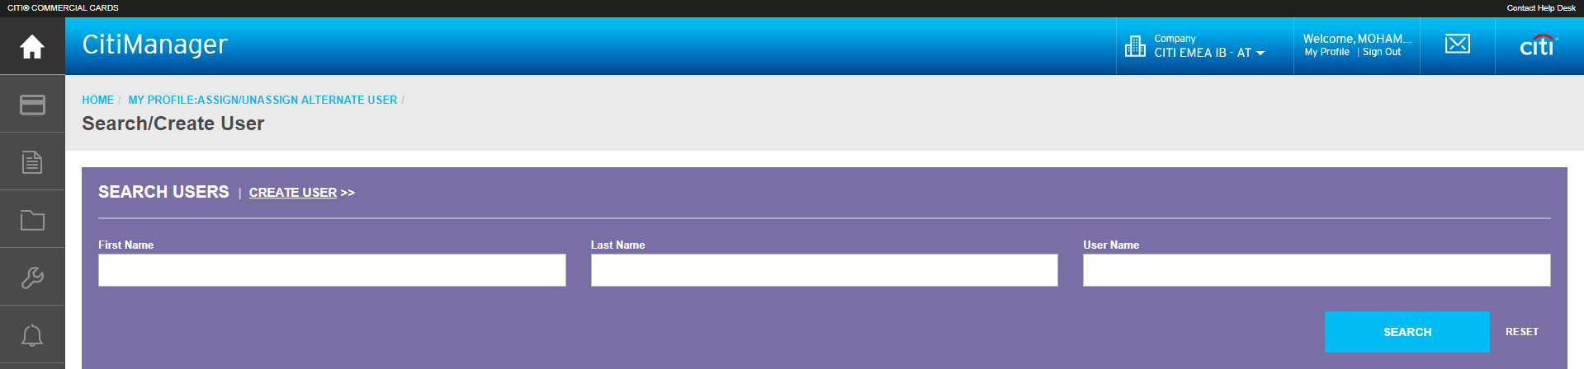
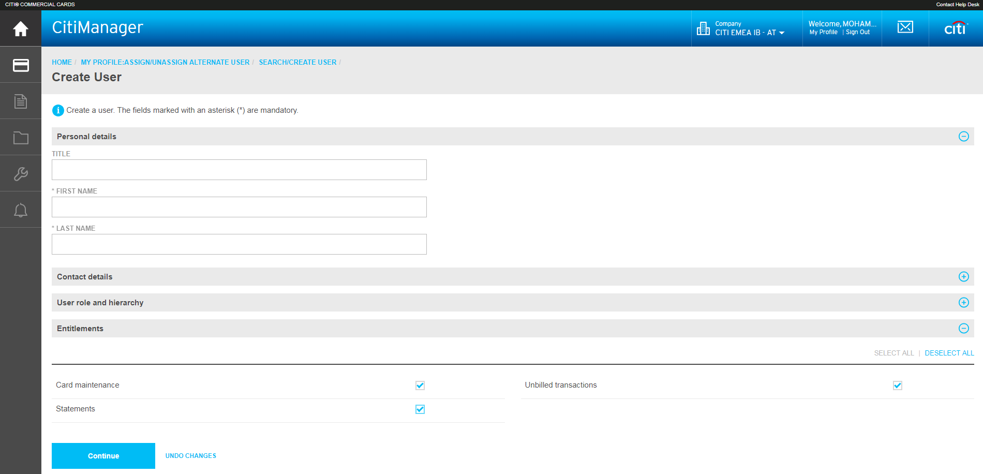
Process overview – Adding APOC or Alternate User
Quick Steps
If you want to assign an existing ‘Alternate User’ to your Card, search for the user with either First Name, Last Name or User Name and click on ‘Assign’.
If you want to create a New ‘Alternate user’ click on ‘Create user’
Update your ‘Alternate Users’ details
  Personal details
  Contact details
  User role and hierarchy
  Entitlements – This is driven by what level of access you want an ‘Alternate user’ to have
Click ‘Continue’ and then in the next page click on ‘Save’
The ‘Alternate user’ will receive the ID and Passcode
5
4
6
7

Slide 4
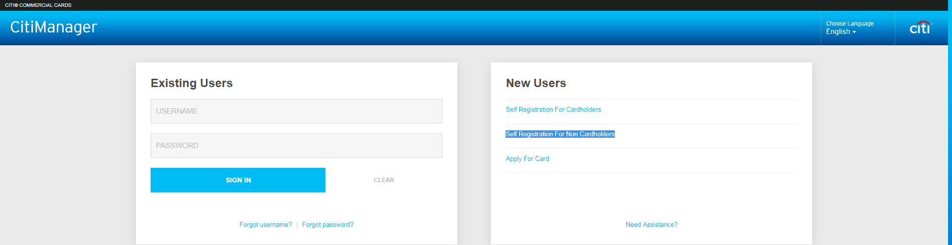
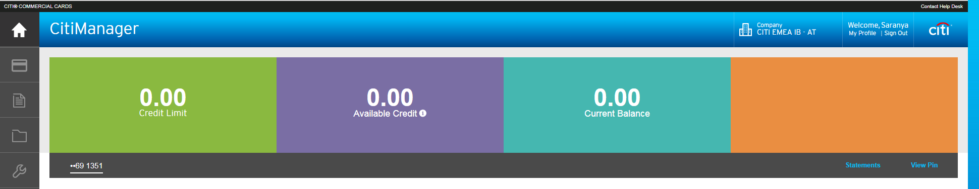
Process overview – Adding APOC or Alternate User
Quick Steps
Alternate user clicks on CitiManager - Self Registration For Non Cardholders option and creates a user ID
The ‘Alternate user is now created and can perform the activity on behalf of the Cardholder
Note : If you want Alternate User to have the entitlement to call Customer service and Inquire on your behalf, there is an additional step to be performed
Kindly fill the APOC form
Send the completed APOC form to your Company Program Administrator (PA)
PA will in-turn send it to Operations team to complete the Setup
9
10

