Slide 1


CitiManager – Set Passcode Process
Treasury and Trade Solutions
Citi Commercial Cards

Slide 2
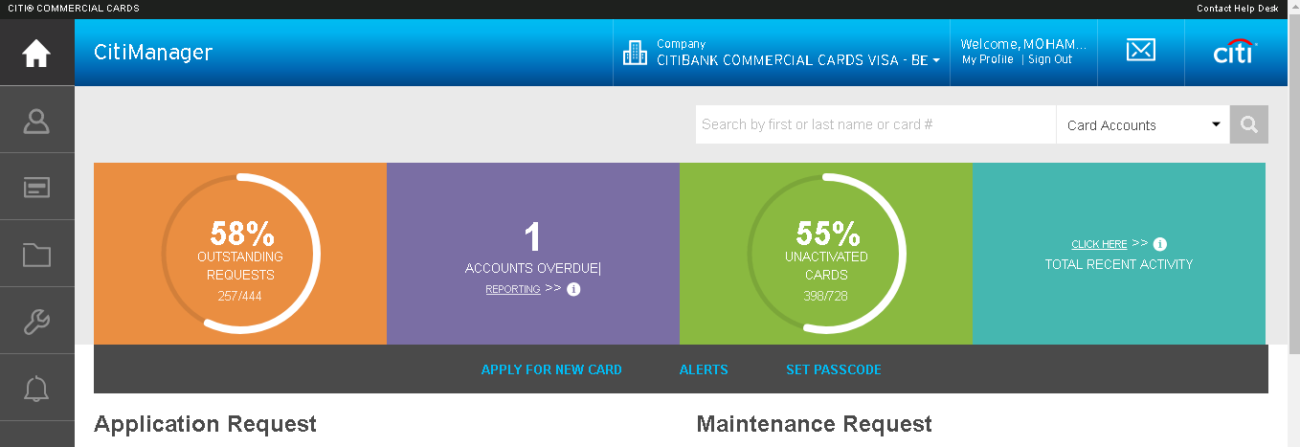
CitiManager – Set Passcodes
Internet address: https://home.cards.citidirect.com/
"In this lesson you will learn how to set passcodes on your corporate hierarchy.“
Under the Quick Links section on the right side, click the Set Passcode link.

Slide 3
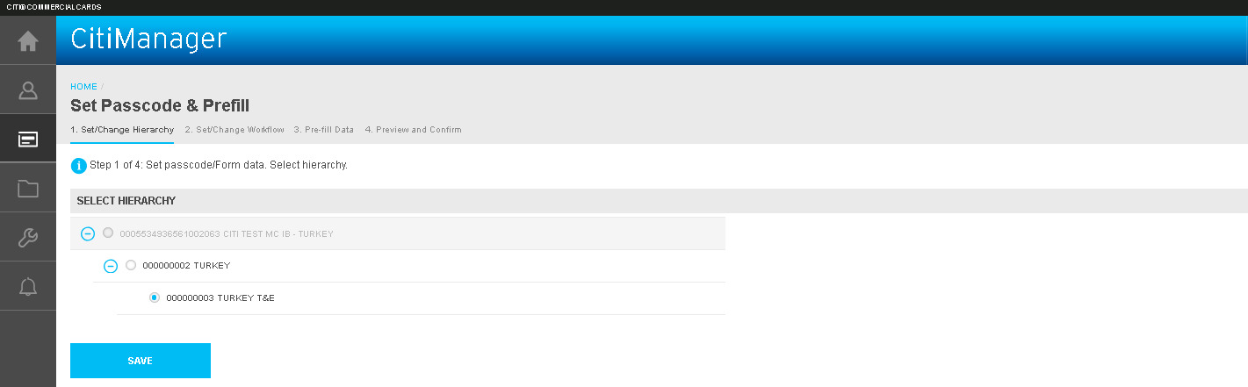
CitiManager – Set Passcodes
Step 2 : You are brought to the Set/Change Hierarchy screen. Click the + (plus sign) to drill down to the desired hierarchy where the passcode should reside.
Select the hierarchy you want the passcode set at. Click the Save button

Slide 4
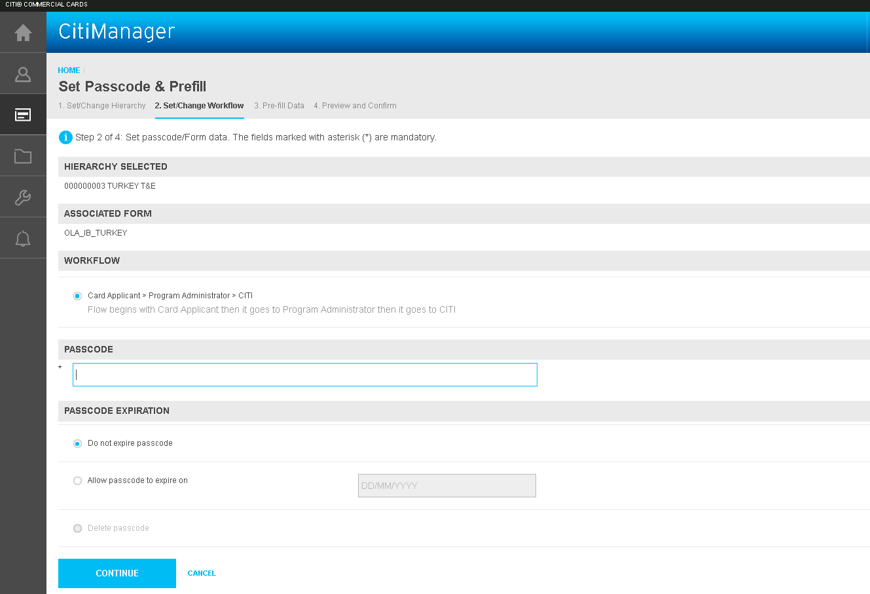
CitiManager – Set Passcodes
Step 3
Next the Set/Change Workflow screen will appear. The work flow will already be enabled.
Please note: Depending on company setup there may be other approval work flows that display.
Enter the new unique passcode into the Passcode field.
You can also determine if you want the passcode to expire or not. If you select the passcode expiry option, you will need to enter the expiry date in the format of: DD/MM/CCYY.
Click the Continue button.

Slide 5
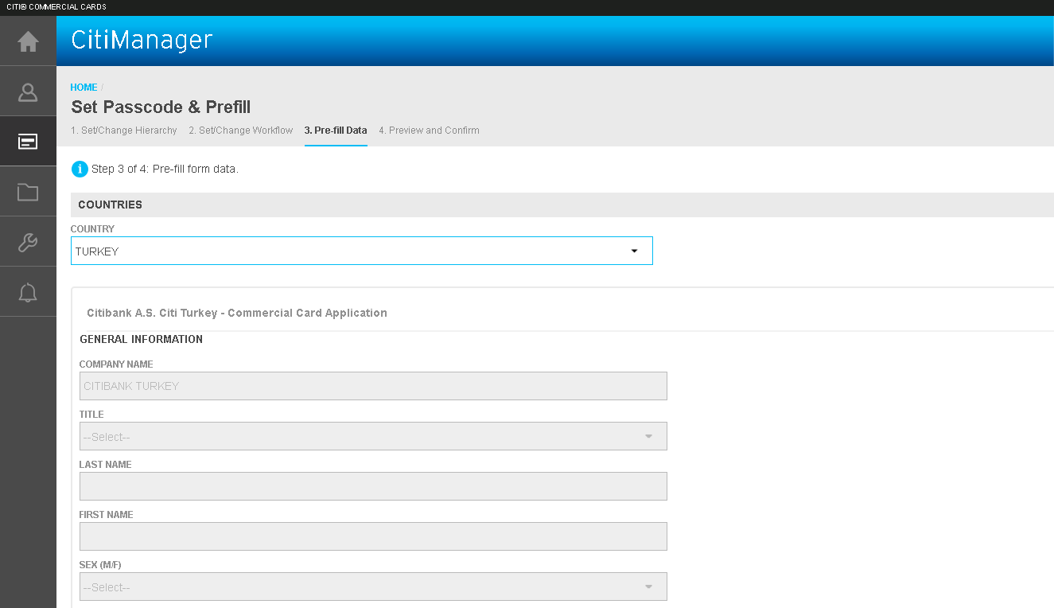
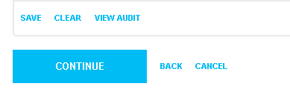
CitiManager – Set Passcodes
Step 4
The application form will appear, where you can pre-fill certain data fields on the application, if the feature is enabled.
Note: If you wish to enable the pre-fill function, please contact your Client Account Specialist or Implementation Manager.
Click the Country dropdown selector and choose the appropriate country.
Scroll down the application form and enter any mandatory or pre-fill fields on the online application form that may be present.
Click the Save button and then the Continue button at the bottom of the form.

Slide 6
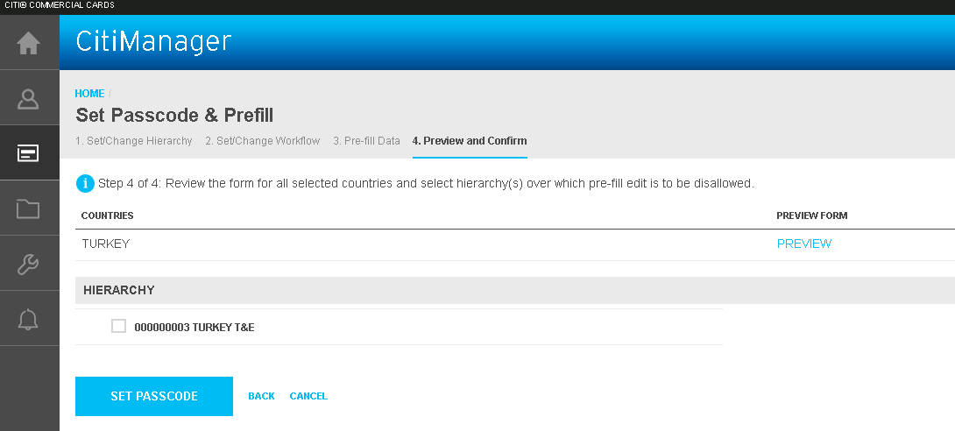
CitiManager – Set Passcodes
Step 5
You are taken to the review screen, where you can preview the form you just edited, by clicking the Preview link or you can proceed with setting the passcode.
To set the passcode click the Set button.
Once you have set the passcode, click the Cancel button to exit to the Manage User Access default screen.

Slide 7




Thank You
Notes:
Simple – Global – Digital

